Slide 1
Discrete and Quantum Fourier Transforms
By: Corbin T. Rochelle

Slide 2
Why should you listen and not sleep?
(Other than the analysis of my presentation being part of the grade?)
Interesting foray to quantum computing
Could make money
Working as a quantum data analyst
Stealing money from banks

Slide 3

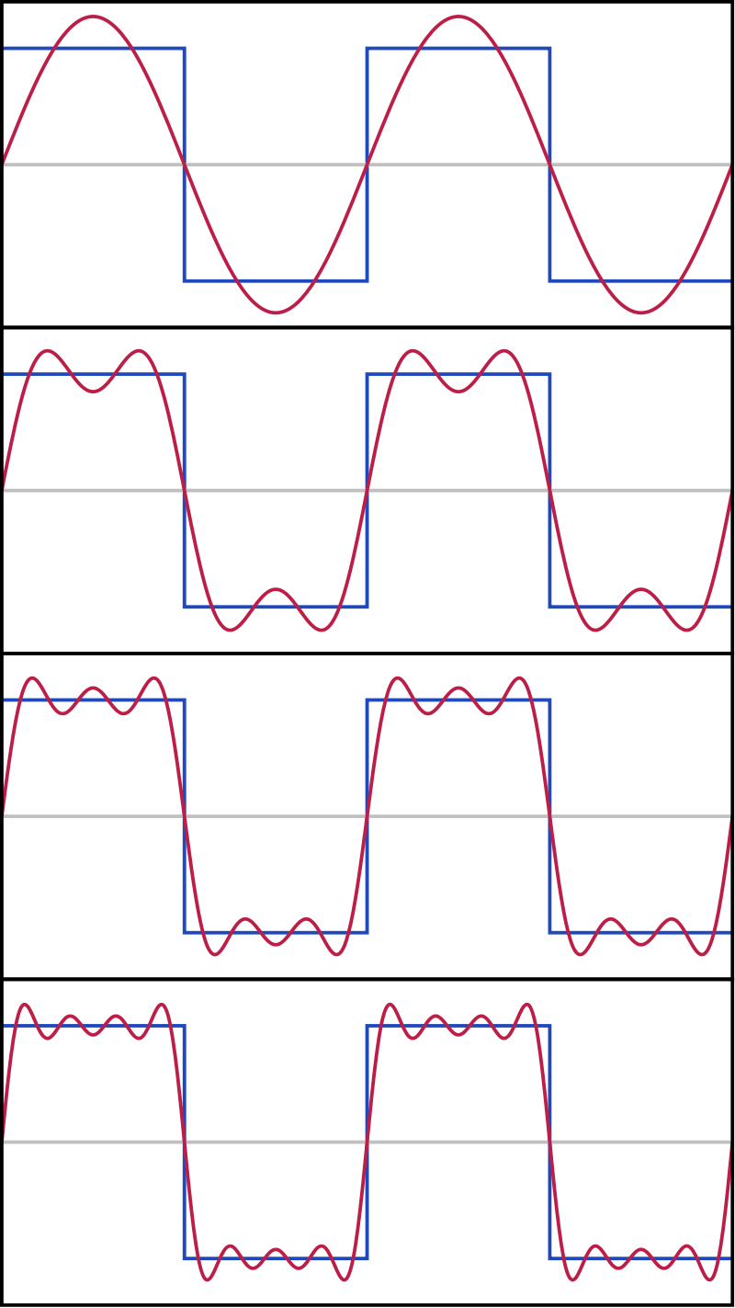
Classic Fourier Series
General Equation of a Fourier Series
Sin(x) and Cos(x) Approximation
More Sinusoidal f(x)’s, More Accurate
Fourier Transform
Time to Frequency Domain
Complications
Only for Periodic (all x’s)
Around a Point for All f(x)’s
S_1
S_2
S_3
S_4
F.S. of Square Wave

Slide 4
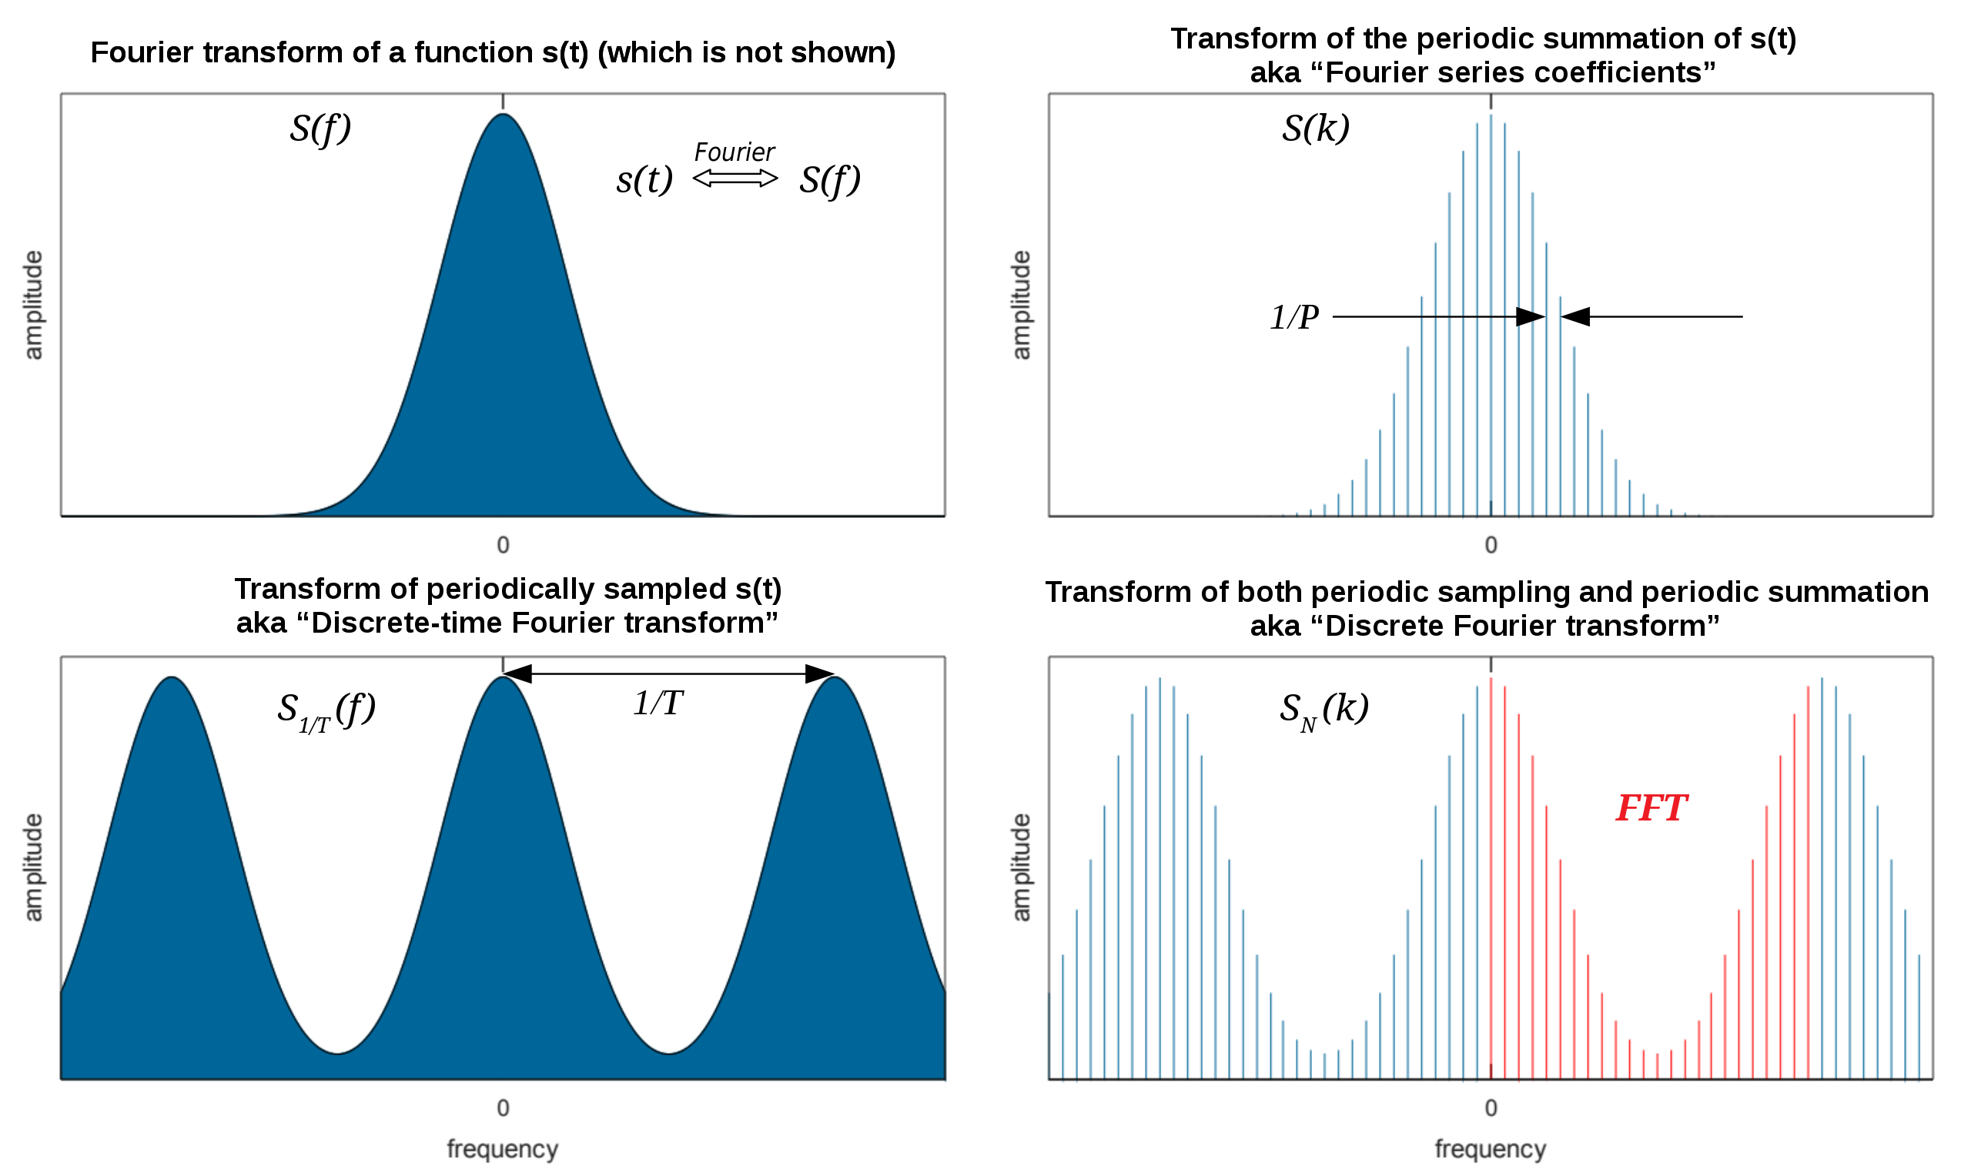


What are DFTs and QFTs?
Variations on Fourier Transform
Discrete Fourier Transform
Exactly as the Name Says
Sampling Rate
Quantum Fourier Transform
Quantum Analog
Same but Qubits, not Vectors
Fourier Transform vs DFT & QFT

Slide 5
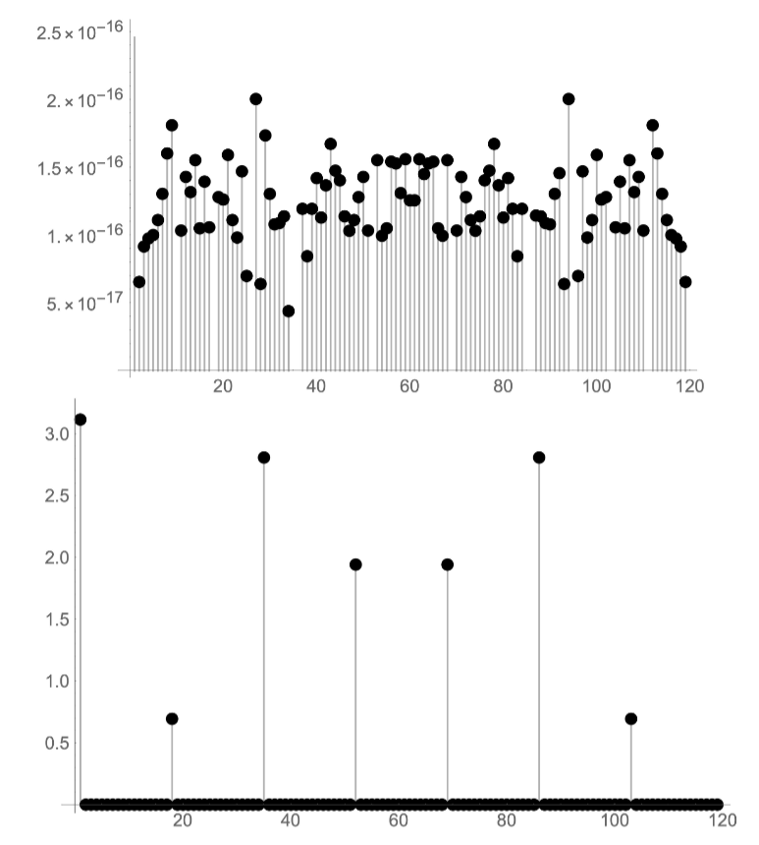
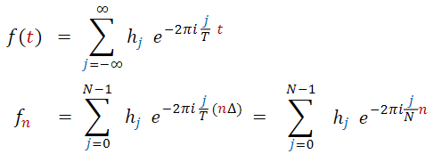
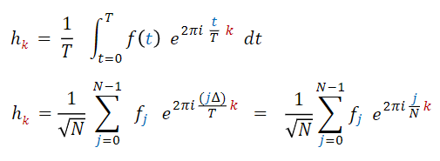
DFTs
Produces Quantized Values
Can be Used on Quantized Data
Important!
Qubits
DFT Applied to Quantized Data
Fourier Transform vs DFT

Slide 6
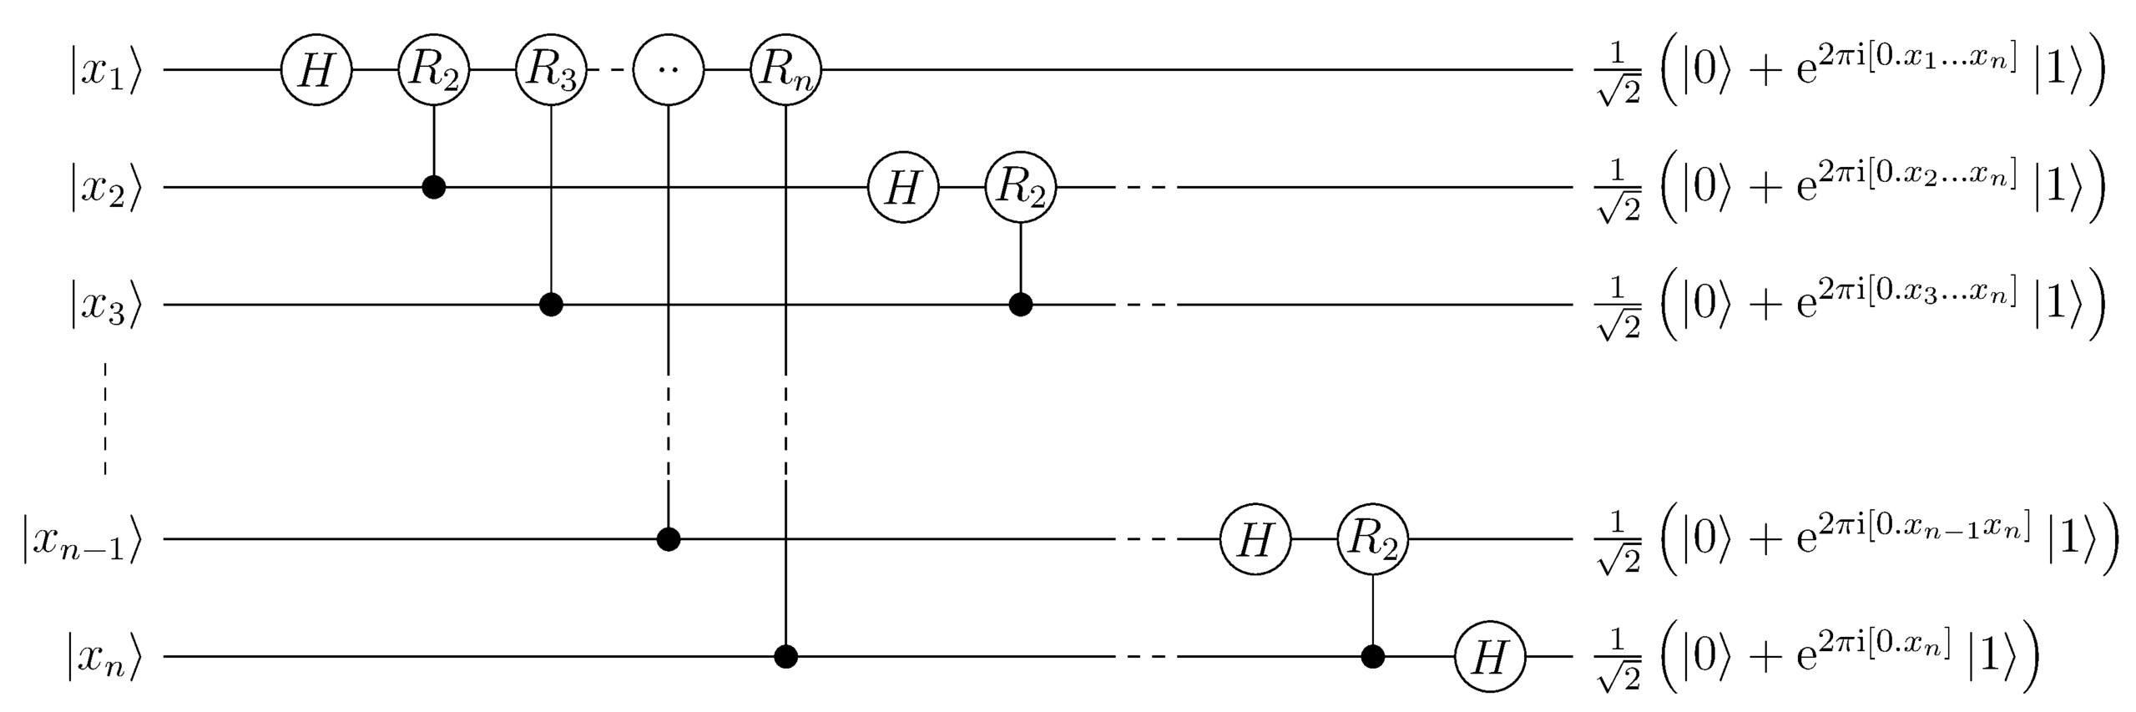



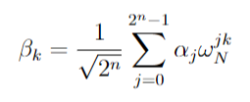
QFTs
Acts on Quantum State
Opposed to a Vector
Otherwise, the Same
Finds Patterns in Qubits
Unitary
Hadamard Gate
Controlled Phase Gate
Mapping onto Ket Y

Slide 7
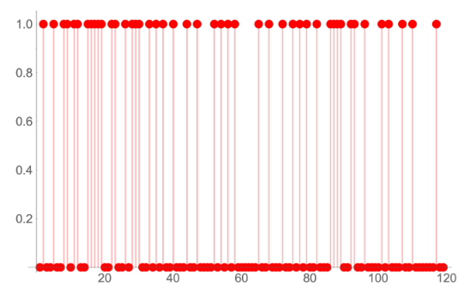
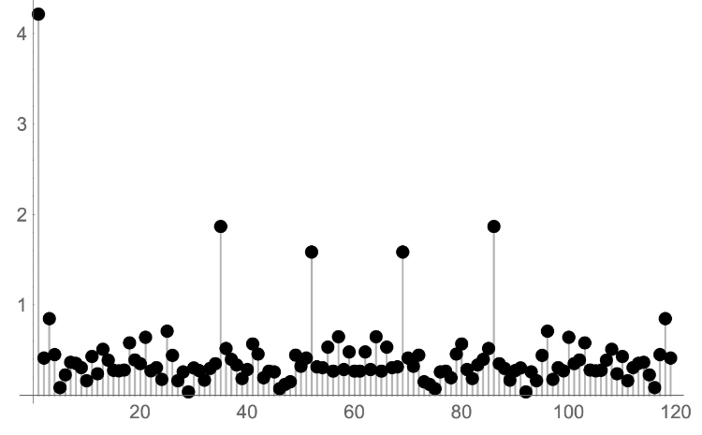

Applications of QFTs
Quantum Phase Estimation
Shor’s Algorithm
Hidden Subgroup Problem
Finite Abelian Groups
Period Formula From QFT
Quantum Phase Estimation

Slide 8
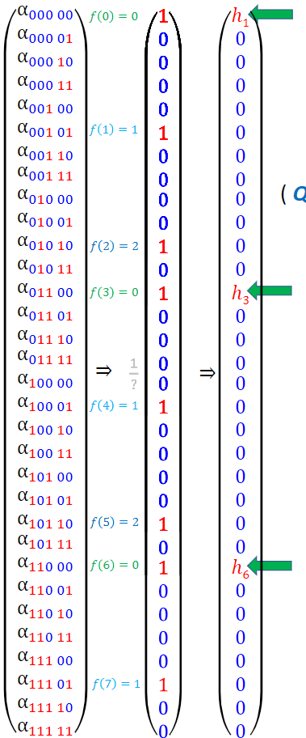
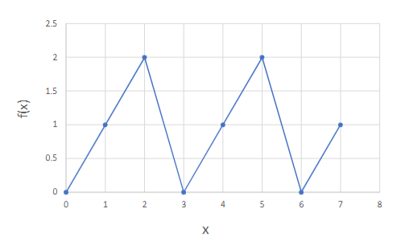

QFT Example
Period
Sample Function

Slide 9
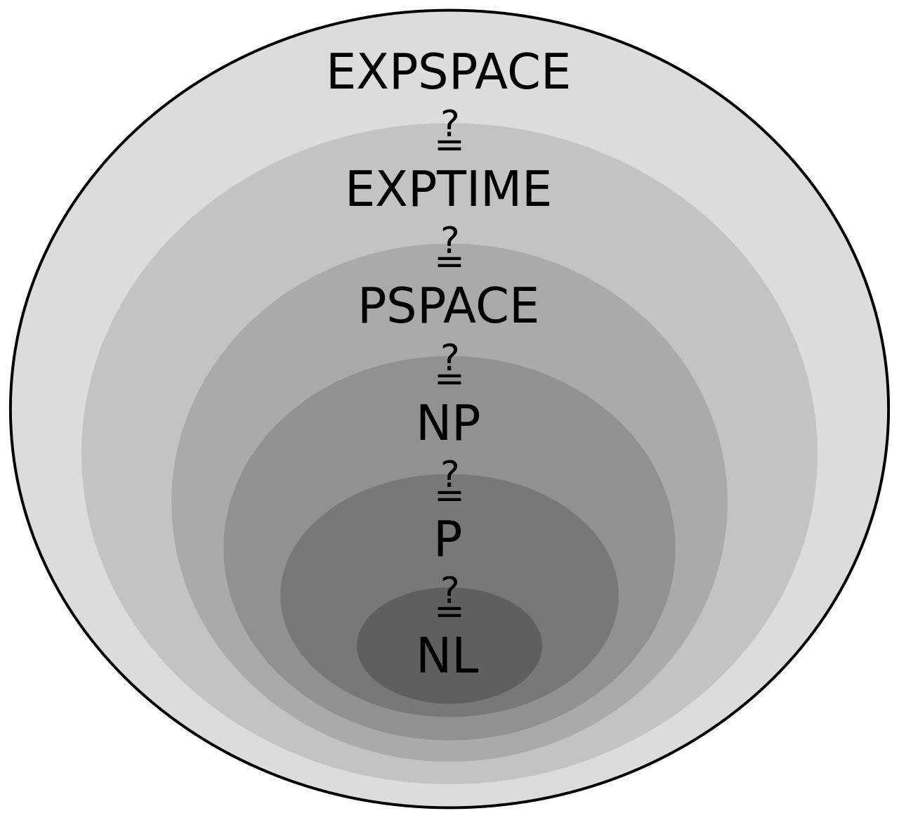
Brief Introduction to Asymptotic Complexity Classes
Computational Problems with Bounded Resource
Time
Memory
Asymptotic Relations
P=NP ?
Polynomial
Non-Deterministic Polynomial Time
Very Important Problem!!!
Complexity Classes

Slide 10
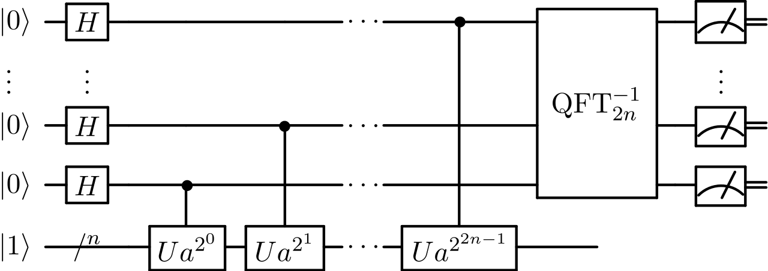
Shor’s Algorithm
Factorization of Primes
For General n ∃ Z
Bounded Quantum Poly. Time
Subset of P!
Simplified Circuit Logic
Classical Circuit
Pick Random #
Find GCD (That is Non-Trivial)
Quantum Circuit
Find U and a from Classical Circuit
Check Period
Obtain Factors from Modular Decomposition of Period
Shor’s Quantum Circuit

Slide 11
How does this relate to E&M 2?
Wave Analysis! (Griffiths 9.1)
Fourier Transforms (pg. 388)

Slide 12
Questions?

